Slide 1
Rockbuster Stealth
Data Analysis Project
Tableau Link:
https://public.tableau.com/app/profile/corina.gugulus/viz/DistributionofCustomersandRevenuebyCountry/DistributionofCustomersandRevenuebyCountry
Corina Gugulus, April 30 2023

Slide 2
Rockbuster Stealth LLC
Is a movie rental company that used to have stores around the world.
Facing stiff competition from streaming services such as Netflix and Amazon Prime, the Rockbuster Stealth management team is planning to use its existing movie licenses to launch an online video rental service in order to stay competitive.
OBJECTIVE
TO LAUNCH THE STRATEGY for the new online video service.

Slide 3
Business Questions
Which movies contributed the most/least to revenue gain?
What was the average rental duration for all videos?
Which countries are Rockbuster customers based in?
Where are customers with a high lifetime value based?
Do sales figures vary between geographic regions?

Slide 4
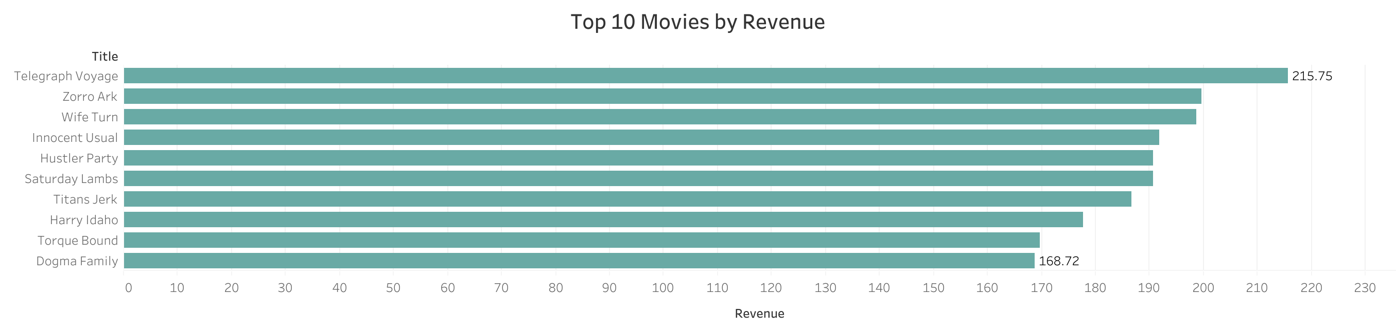

Slide 5
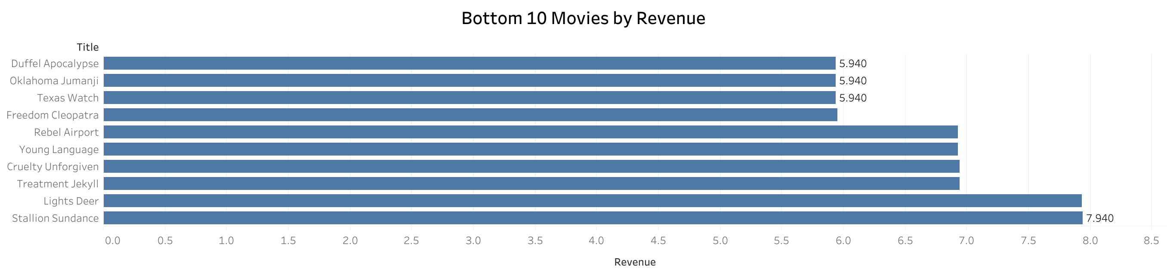

Slide 6
Statistical Analysis
Rental Duration Rental Rate
Minimum: 3 days. Minimum: $0.99
Maximum: 7 days Most Rented Category Maximum: $4.99
Average: 5 days PG-13 Average: $2.98
Movie Length Replacement Cost
Minimum: 46 mins Minimum: $9.99
Maximum: 185 mins Maximum: $29.99
Average: 115 mins Average: $19.84

Slide 7
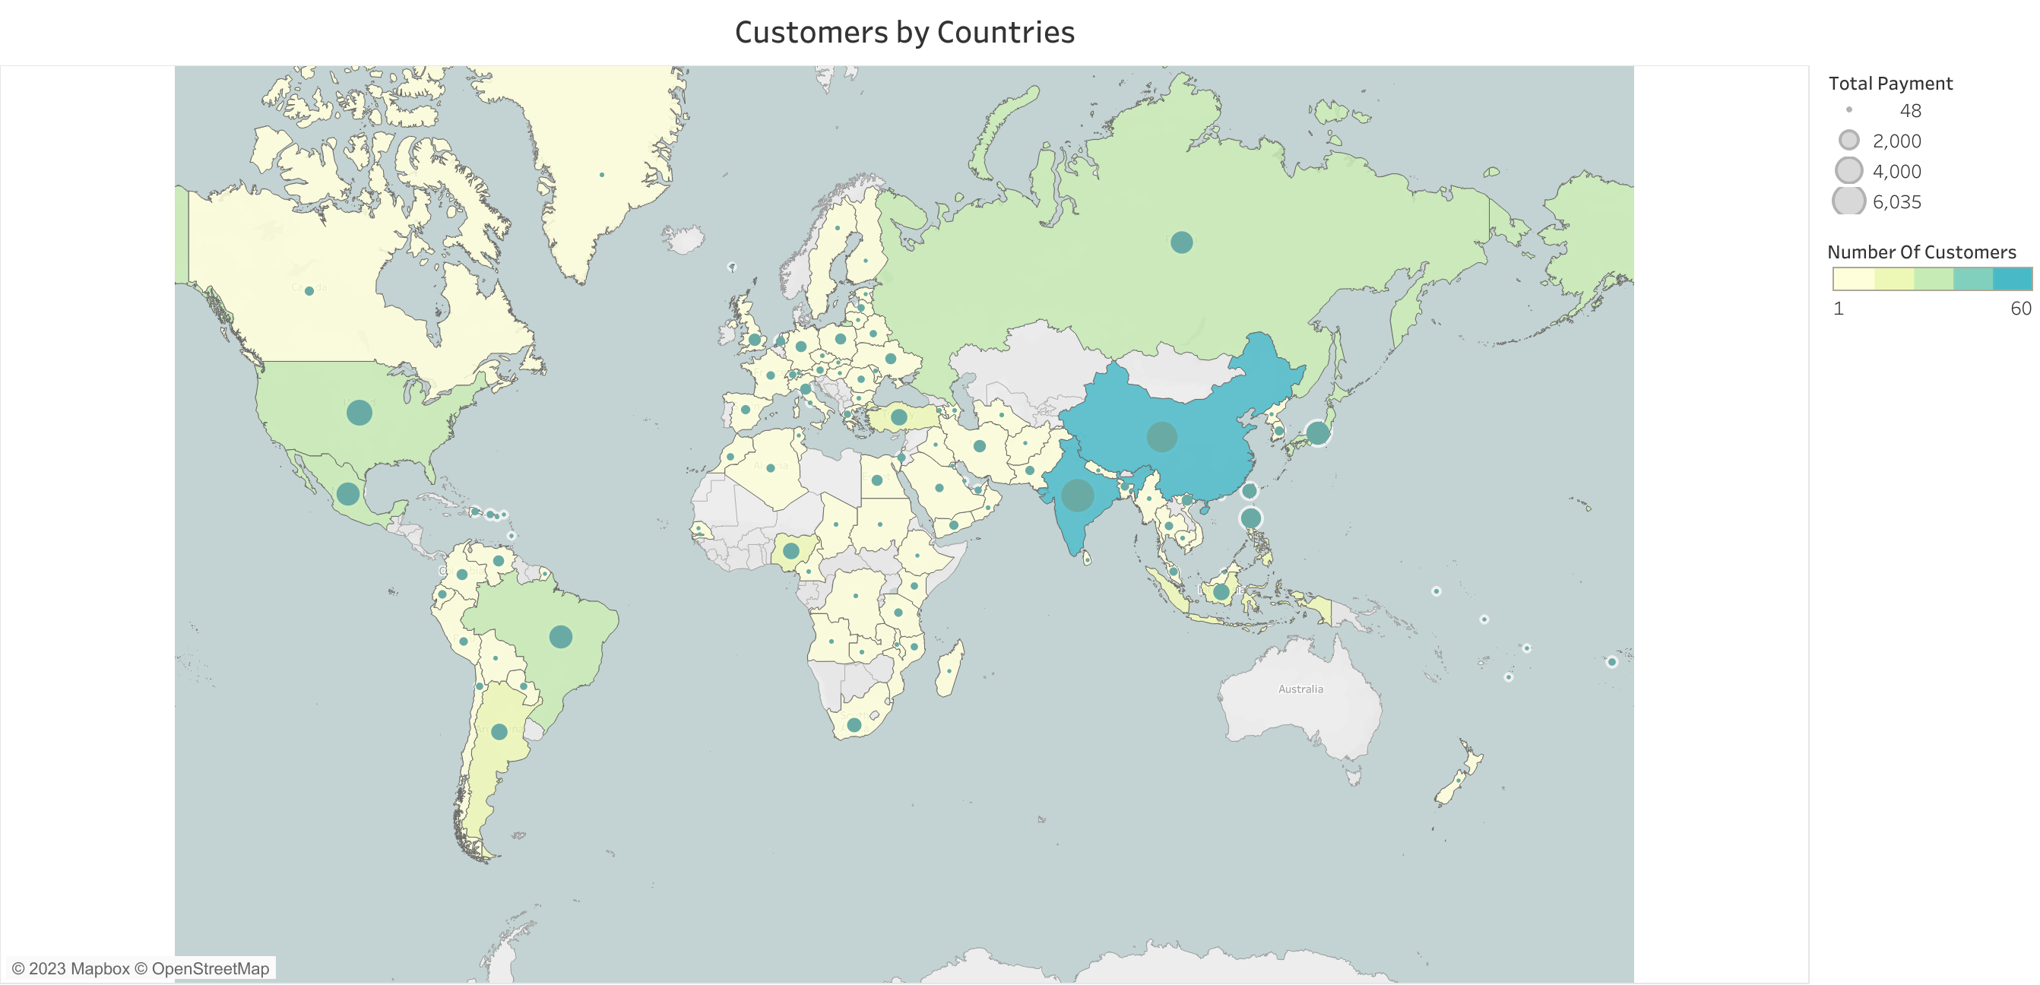

Slide 8
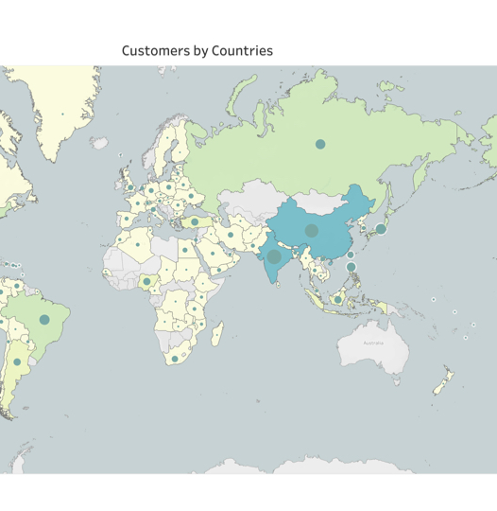
Which countries are Rockbusters customers based in?
Customers Distribution by Countries
China is on the first place with the highest number of customers and $ amount in revenue
India is on the second place
US, Japan, Mexico and Brazil on the third, forth, fifth and sixth place respectively

Slide 9
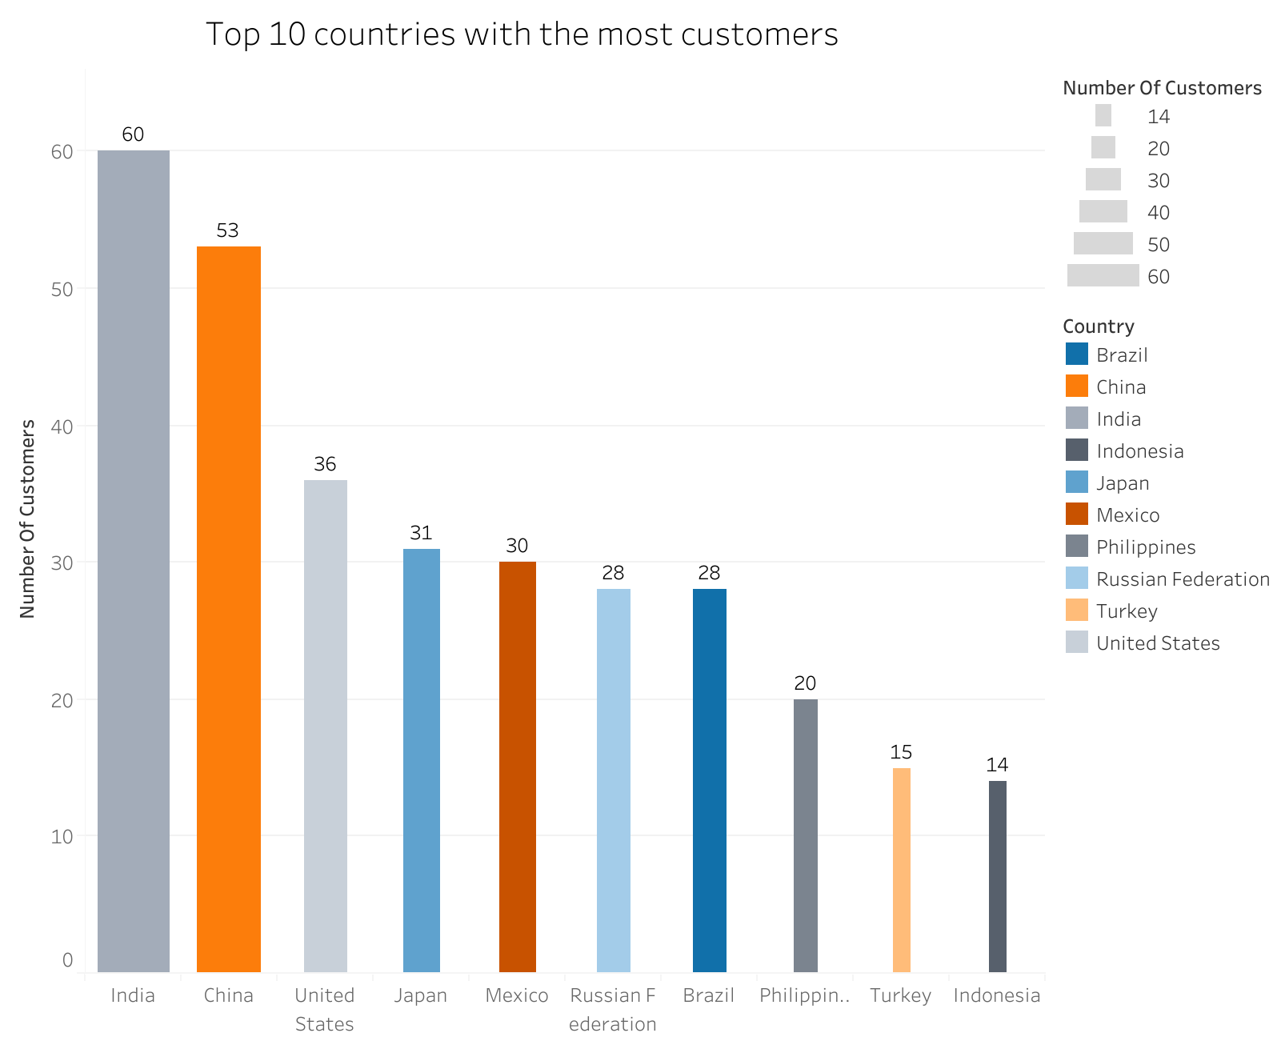

Slide 10
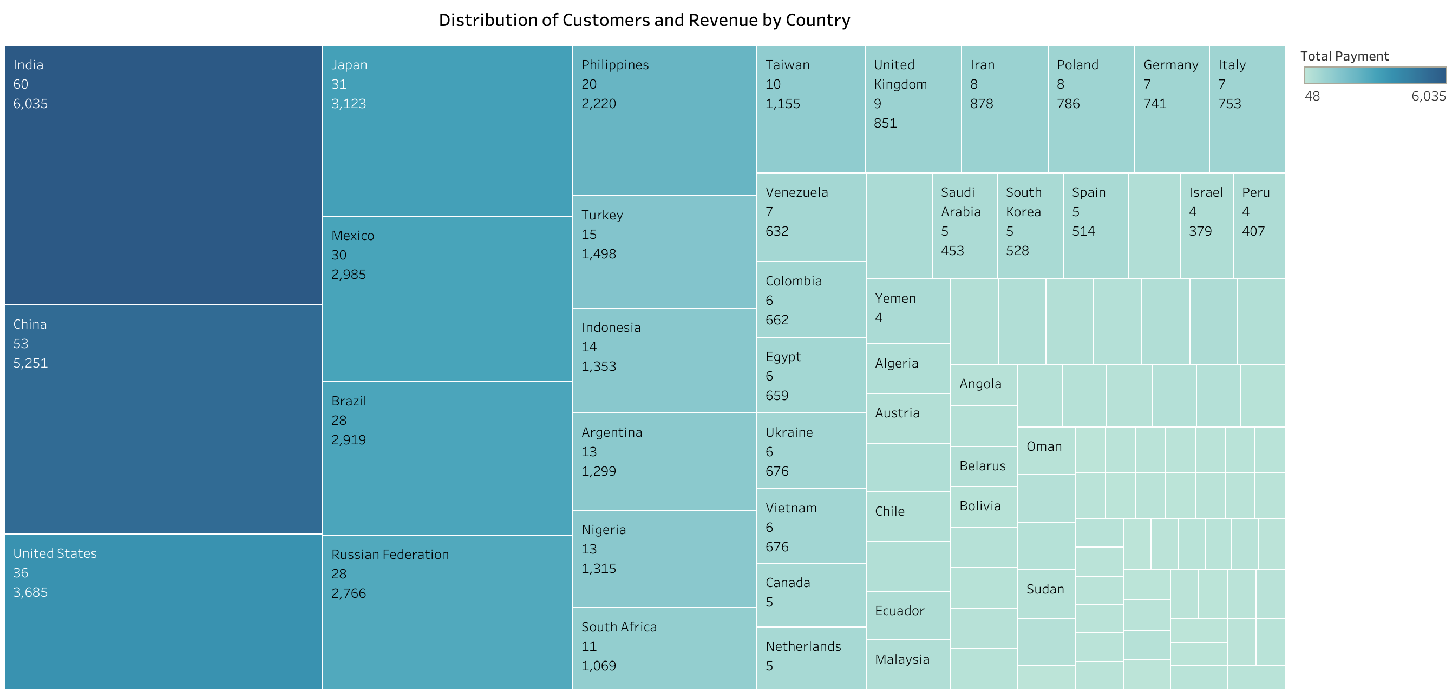

Slide 11
Summary and Recommendations
Summary
Sales figures vary between geographic regions, the most profitable regions being Asia, North America and South America
Countries with the highest number of customers are India, China and USA
Recommendations
Rockbuster Stealth LLC should continue to focus on Asia, North and South America for the new online video service, especially on countries such as India, China and USA
Rockbuster Stealth LLC should reward their top 10 loyal customers
Rockbuster Stealth LLC should have an incentive program to attract new customers through their loyal customers by offering new perks to the old customers
Further analysis on movie titles to see what movies appeal to what type of audience for each country to increase revenue

